Slide 1
A beginner’s bioinformatics guide for single cell RNA-seq analysis
Tommy Tang
Youtube channel: Chatomics
Divingintogeneticsandgenomics.com

Slide 2
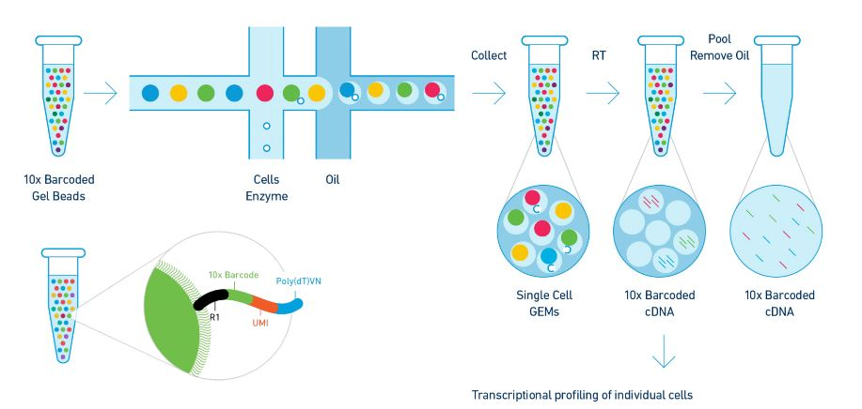
10x single-cell gene expression solution
Notes:
There are many single cell platforms and one of the most popular ones was the droplet based technology which is commercially available from 10x genomics.
You can buy Barcoded gel beads from the company, every bead has a unique barcode sequence.
You then prepare single-cell or nuceli suspension, and then run them through the 10x machine, at a right speed, a single gel bead will be associated with a single cell within a single oil droplet.
The RT reaction occurs within the oil droplet and each mRNA from the same droplet is tagged with the same barcode. We can then later computationally group the transcripts to the same cells after we get the data.
Load 10,000 cells per lane

Slide 3
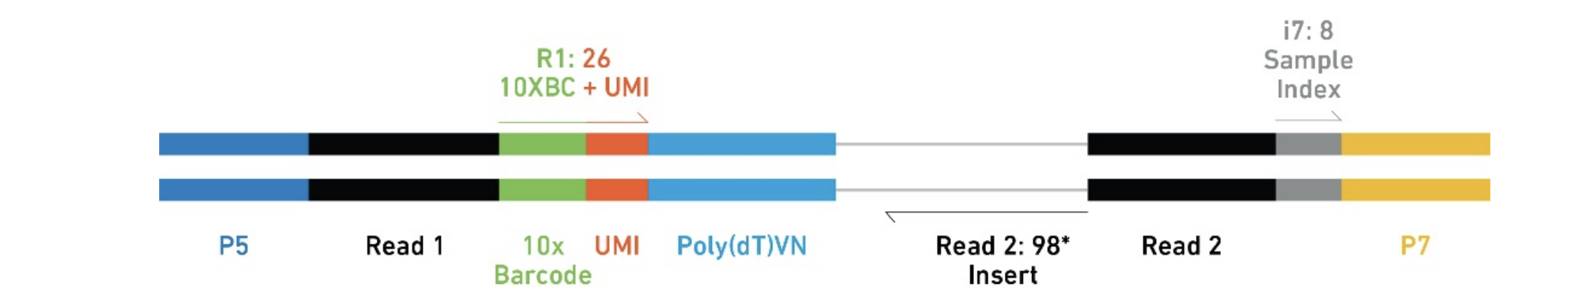
10x single-cell gene expression solution
10x scRNAseq library
16 bp cell barcode
10bp (V2) vs 12bp (V3)
Unique Molecular identifier (UMI)
UMI count
Notes:
This is the final look of the sequencing library for scRNAseq data. P5 and P7 are illumina sequencing adaptors.
R1 read or forward reads are comprised of a 16 BP cell barcode and a 10 bp or 12 bp UMI. The UMI is added to each mRNA molecule and can be used to de-duplicate the reads after PCR.
R2 reads contain the genomics information plus a 8bp sample index. Load 10,000 cells per lane

Slide 4
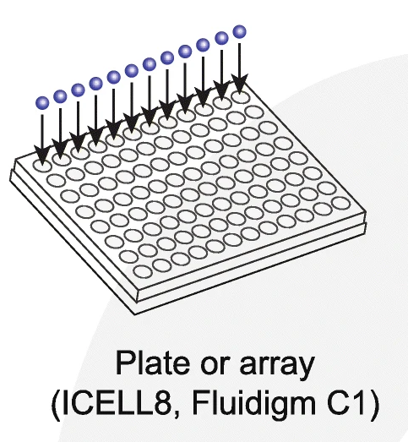
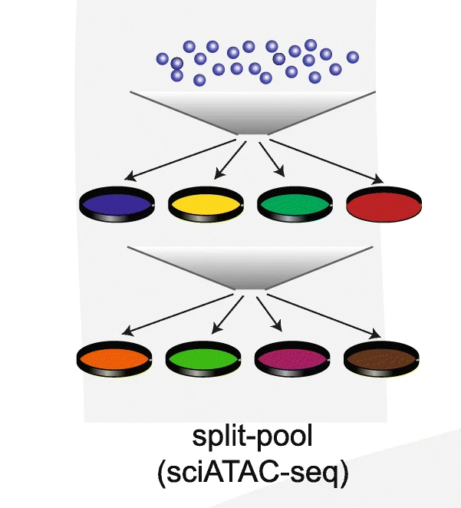
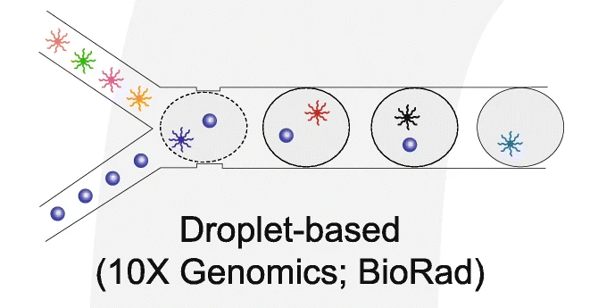
Different scRNA-seq Techniques
Takara Bio SMART-seq
SPLiT-seq (parse bioscience)
https://www.youtube.com/watch?v=WqaeZe7mKUc
Chen et al, Genome Biol 2019
Notes:
Other methods in addition to the droplet based are being developed.
There is the Plate based method in which the cells are sorted into a single well on a plate. SMART-seq is non-UMI based, but it sequence full length mRNA and usually have much deeper sequencing with fewer cells than 10x.
Split and pool strategy. The cells are split into different plates and added first round of barcode, then the cells are pooled and split into different plates where a second round of barcode are added.
Every cell undergoes a distinct path as marked by the barcode added at each step. After sequencing, the unique sequences of the barcode can be used to group the transcripts from the same cell.
You need a lot of cells to start with because each round can lose some cells. This platform is available from a company called parse bioscience

Slide 5
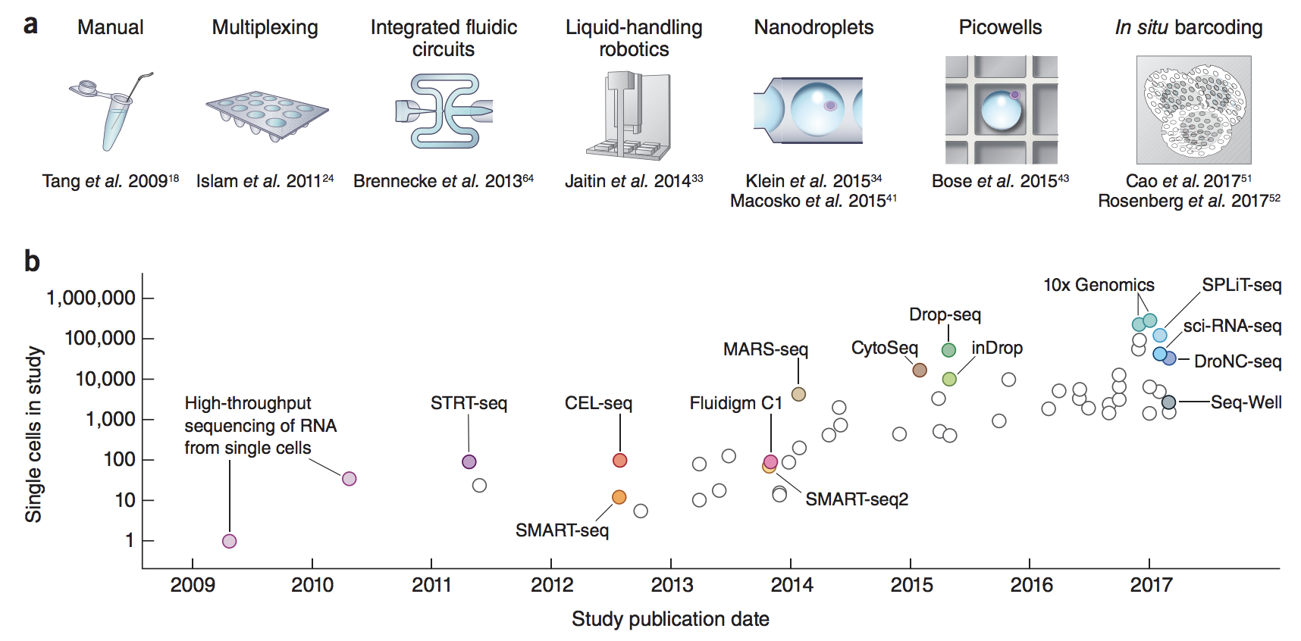
Exponential increase in throughput and new smart tech
CITE-seq
Ab-seq
Cell hashing
Multi-seq
scifi-seq
sci-RNA-seq3
Perturb-seq
dcPerturb-seq
SMART-seq3
SMART-seq4
SMART-seq total
SNARE-seq
SHARE-seq
DroNc-seq
Scito-seq
CEL-seq2
SeqWell
SeqWell s^3
SCRUB-seq
mcSCRUB-seq
SureCell 3’ WTA (ddSEQ)
Quartz-seq
Quartz-seq2
BD Rhapsody
Microwell-seq
10x 5’ (TCR/BCR-seq)
10x Feature barcoding.
……+++
Luciano Martelotto
Svennson et al., Nature Protocols (2018)
Notes:
The available technologies are increasing exponentially in terms of throughput. The earliest single cell sequencing can be traced back to 2009. many other technologies were developed after that including the ones I shared before.
Single-cell genomics is a fast-forwarding field, best practice for analyzing the data also changes with new single-cell papers/tools come out almost every week.

Slide 6
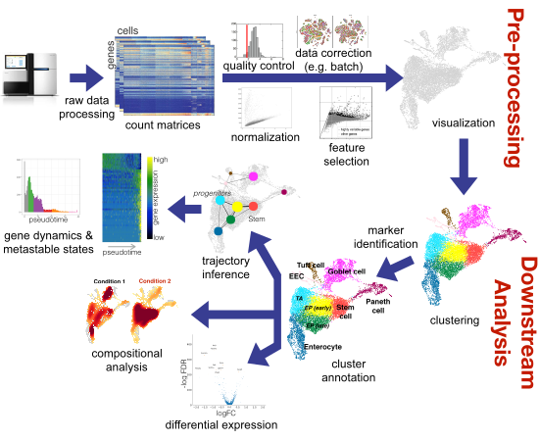
Let's walk sprint through a typical* scRNA-seq analysis
Luecken, M. D. & Theis, F. J. Current best practices in single‐cell RNA‐seq analysis: a tutorial. Mol. Syst. Biol. 15, (2019).
Lib size etc. SCTransform in Seurat
Dimension Reduction:
PCA
TSNE
UMAP
Credit to Peter Hickey
Notes:
Let me walk you through a typical scRNAseq analysis.
Get the raw fastq data off the sequencers, align the data to the transcriptome and get a gene x cell count matrix. Then, you carry out quality control to filter out bad quality cells, normalize the data to its library size.
Select the most variable features because not every gene is informative and visualize in low dimension with a PCA/TSNE or UMAP. Then you perform unsupervised clustering to define cell types or cell states.
You can then carry out differential gene expression among clusters to find marker genes and perform cluster annotation. If you have a case-control experiment, you can carry out differential expression or differential abundance analysis between groups. Lastly, you can do trajectory inference to study the transition of cell states along the pseudo-time. I will dive into each step in my following talk.

Slide 7
Read Alignment and gene quantification
Cell Ranger (10X Genomics) solution: cellranger count
RNA-seq: STAR
STARsolo (Blibaum et al, F1000 2019): 10X faster than CellRanger
Alignment free:
Salmon Alevin
Kallisto bustool
Resolve cell barcode and correct barcode sequencing errors
Notes:
First, read alignment and quantification.
The fastqs need to be aligned to a transcriptome. Cellranger is the 10x genomics solution, it uses STAR to align the reads internally. One of the alternative is STARsolo developed by Alex in Cold sprint Harbor who developed STAR too. It is much faster than cellranger and gives almost identical results as cellranger.
There are also the so called alignment free tool such as salmon and Kallisto for bulk-RNAseq. They are much faster because they are not aligning the reads to the transcriptome base by base rather it is only checking whether the reads is compatible with a given transcript model. Both have evolved to quantify single-cell data.
Remember, sequencing can have errors, all those tools do some sort of barcode correction using a white list based on hamming distances.

Slide 8
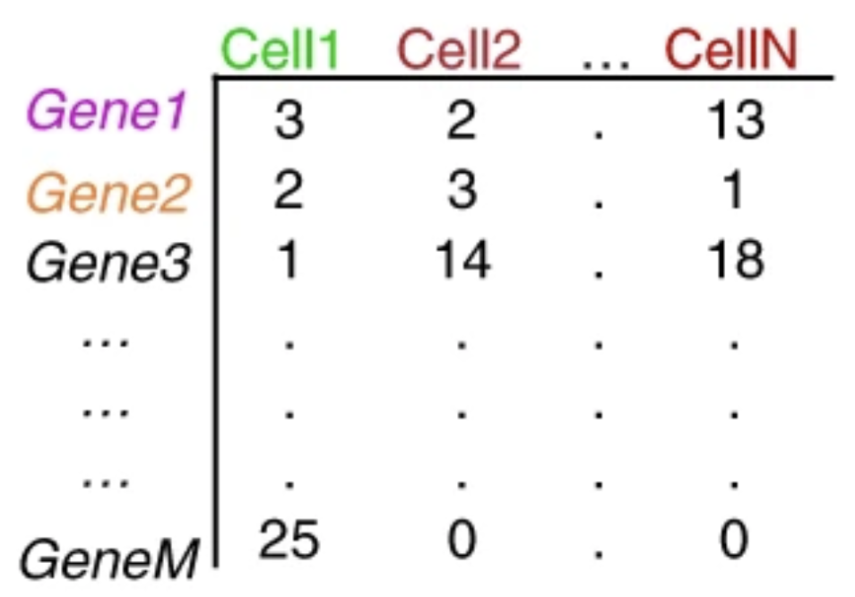
Sparse matrix
Sparse: many 0s in the matrix
https://www.nature.com/articles/s41596-018-0073-y
Notes:
The end results you get from the quantification is a gene by cell count matrix. The rows are genes and columns are cells. The single-cell count matrix is sparse meaning there are many 0s in it.
While the proportion of zeros in bulk RNA-seq data is usually 10–40% that proportion can be as high as 90% in scRNA-seq data.
Why is it a challenge?
imputation, and binarization

Slide 9
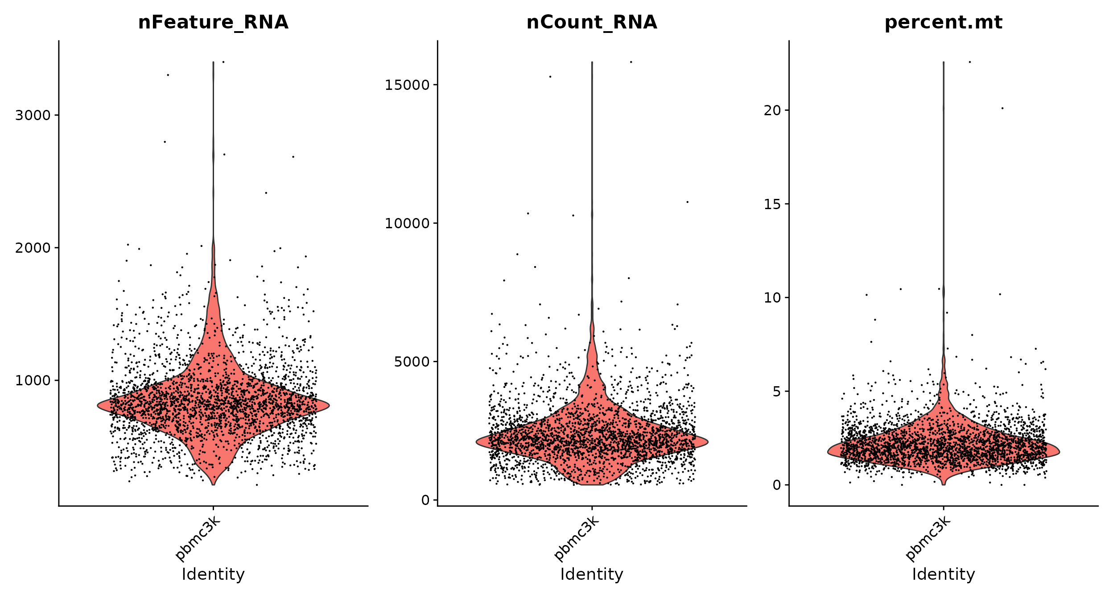
Quality control/doublet removal
Notes:
After you get the count matrix, we need to carry out quality control to remove bad quality cells. Number of genes detected in each cell (200), total number of UMI counts in each cell.
Doublet etc

Slide 10
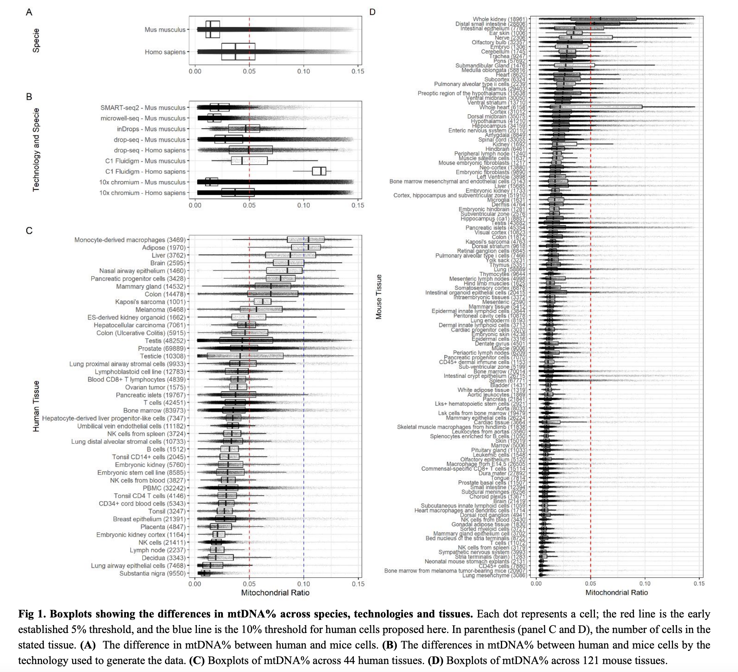

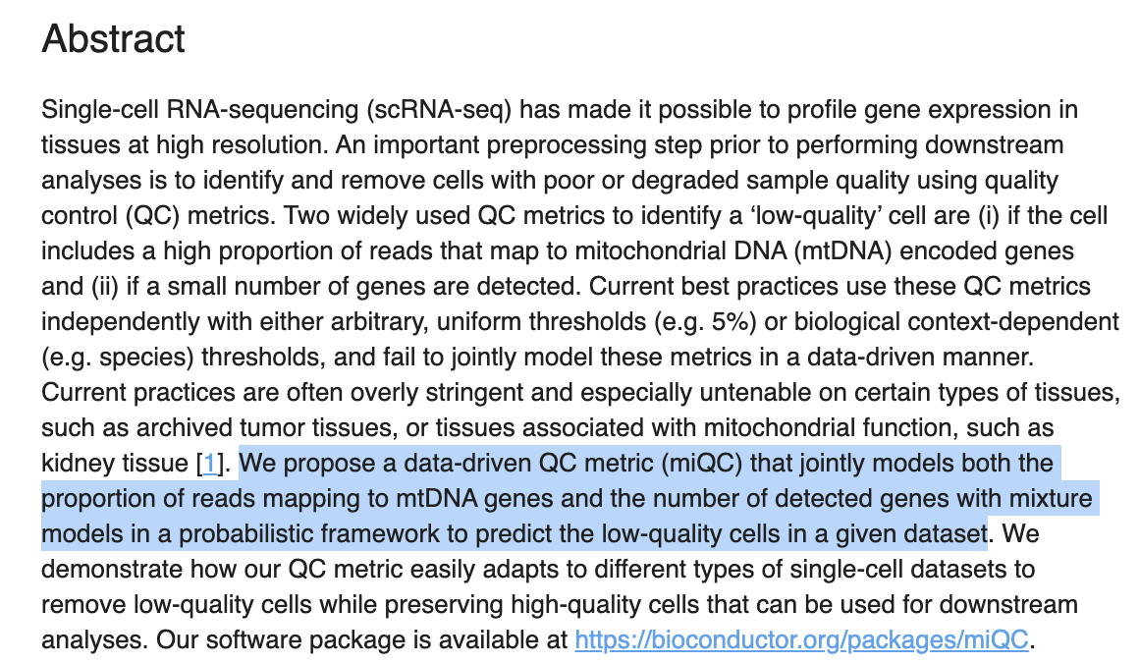
Mitochondrial gene content cutoff
Osorio et al 2020 Bioinformatics
Notes:
I was joking once: 90% bioinformatics problem is determining a cutoff

Slide 11
Normalization and scaling
Bulk-RNAseq
Reads per kilobase of exon per million reads mapped (RPKM)
Transcript per million (TPM)
Single-cell RNAseq
LogNormalize: log(n/library_size *10^6)
scTransform
Scaling:
Shifts the expression of each gene, so that the mean expression across cells is 0
Scales the expression of each gene, so that the variance across cells is 1
This step gives equal weight in downstream analyses, so that highly-expressed genes do not dominate
Notes:
Different cells are sequenced to different depth. We need to do some normalization before any downstream analysis. For bulk-RNAseq, count per million, transcript per million
RPKM nornmalize to lib size first then gene length.
TPM normalize to gene length first and then to the total lib size. In other words, Transcripts per million (TPM) is a measurement of the proportion of transcripts in your pool of RNA and is considered more comparable across samples.
In the paper, they showed tjhat different groups of genes cannot be normalized by the same constant factor, representing an intrinsic challenge for scaling-factor-based normalization schemes.
scTransfrom uses regularized negative binomial regression to model the data and shows better performance. they calculate the Pearson residuals of this model, representing a variance-stabilization transformation that removes the inherent dependence between a gene’s average expression and cell-to-cell variation.
scTransform can be time and memory consuming for large dataset.

Slide 12
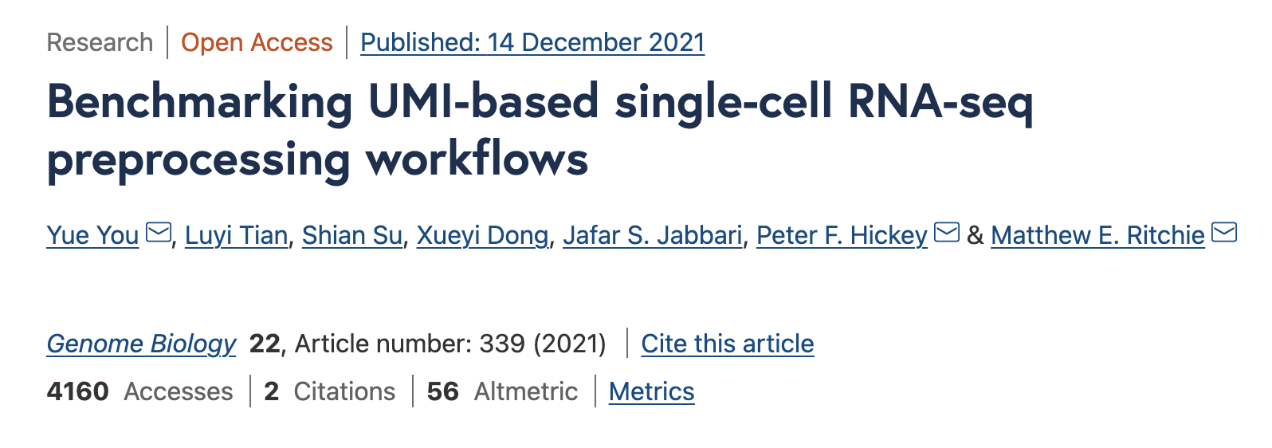
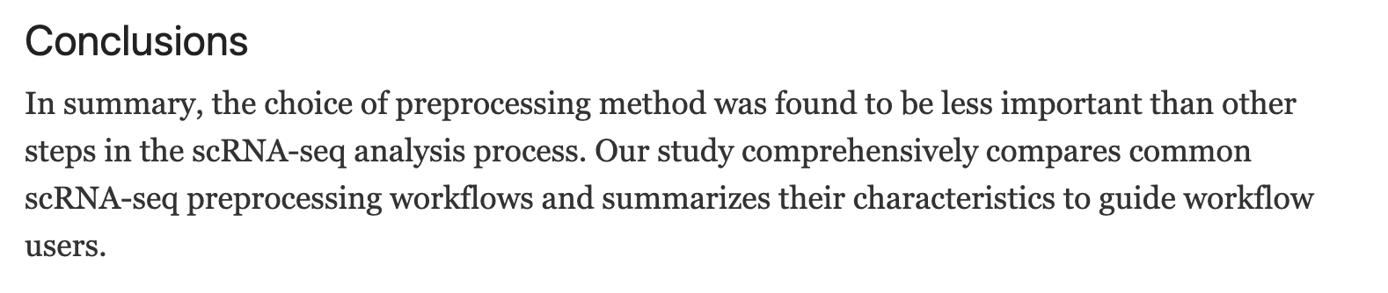

Slide 13
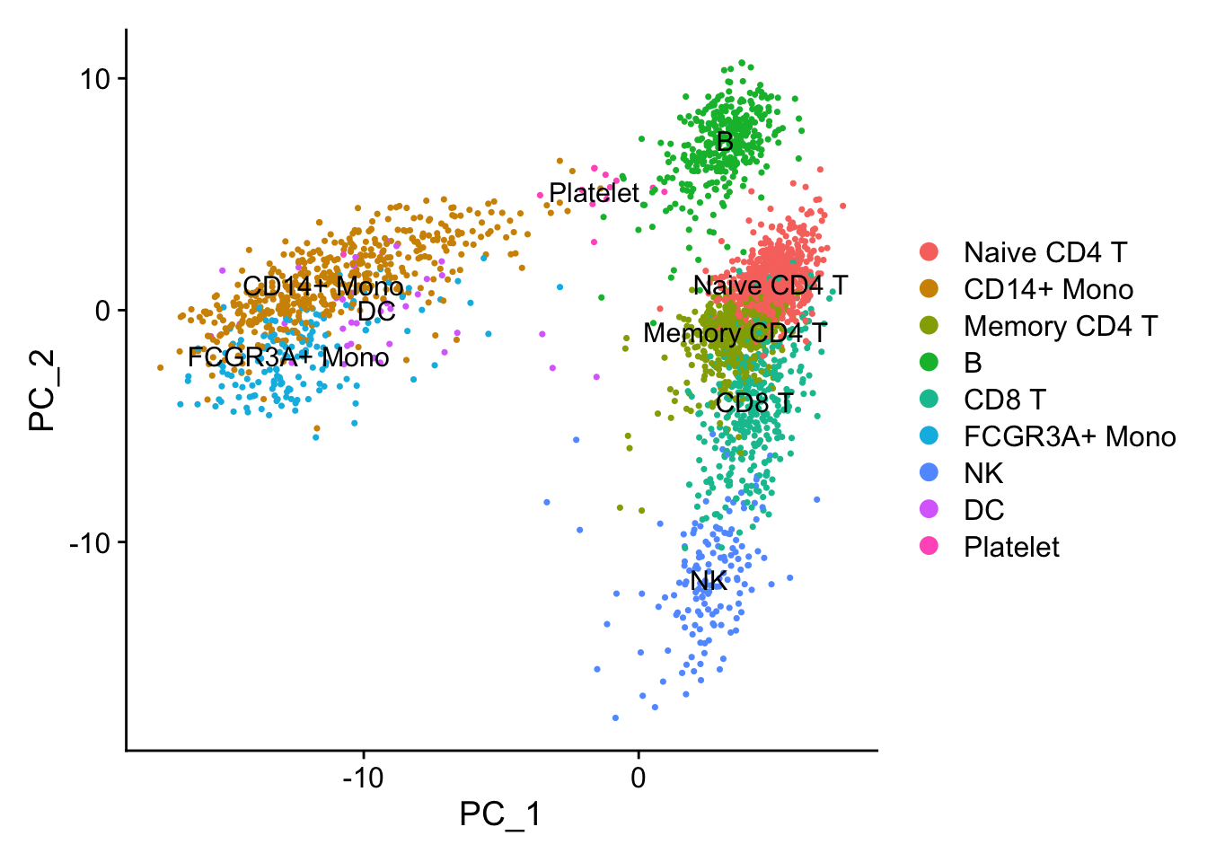
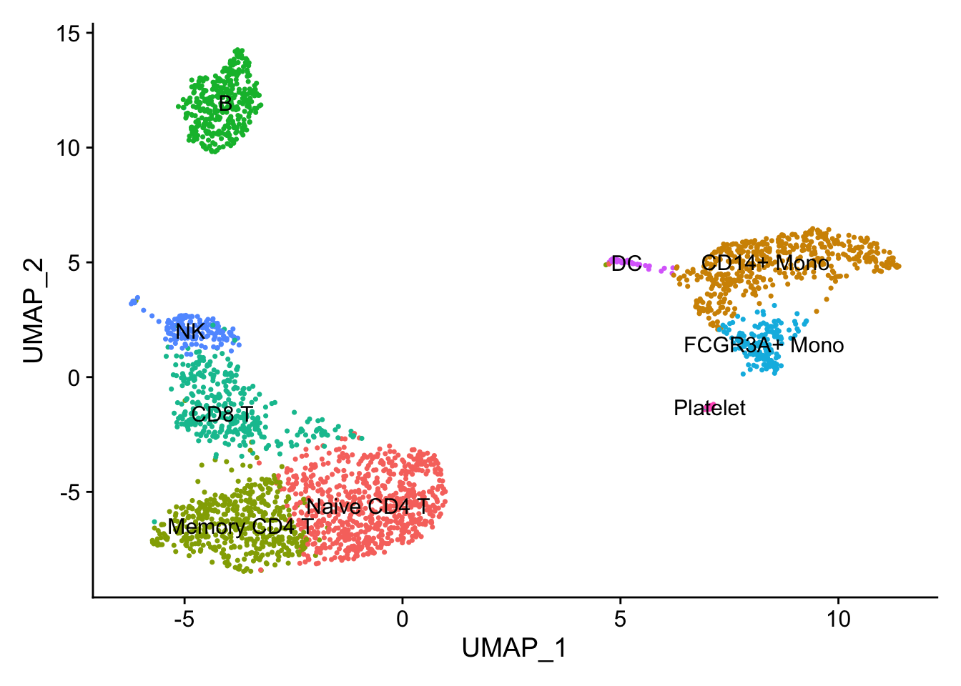
Dimension reduction (PCA vs UMAP)
https://divingintogeneticsandgenomics.rbind.io/post/pca-in-action/
Notes:
When you have two genes and multiple cells, you can plot them in two dimension. When you have 3 genes, you can plot them in a three D. when you have thousand of genes, you will need to do dimension reduction in order to plot them on a 2D space.
PCA, principal component analysis is a key technology for dimension reduction. One key feature is that it is linear so the distance between the points means something. In this peripheral blood mononuclear cells
Dataset, we can see the cell types can be somehow distinguished in the PCA space.
PCA is great, but only if the first two components capture the most variance, you can easily separate different cell types. For subtle differences, the first two components can not easily see them.
Of course you may find the difference by plotting PC3 vs PC4 but that defeats the purpose of only showing one graph and grasp the whole structure of the data.
UMAP is a non-linear projection of high-dimension data to low dimensions. And you see how nicely it serrates the different clusters.
But do not overly interpret UMAP, it is merely a way to visualize the data. And tweaking parameters will give you drastically different looking of the UMAP plot.
The distance does not mean much. You can not say B cell is further to CD4+ cells than NK cells, so B cells is more different to CD4+ cells than NK cells.

Slide 14
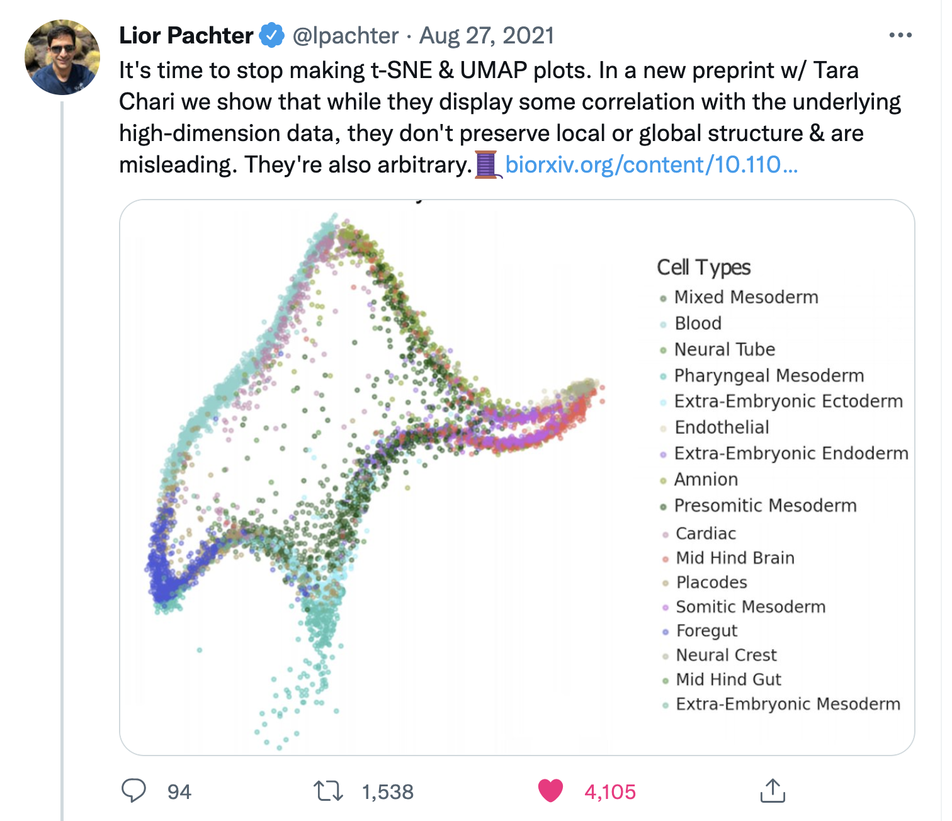
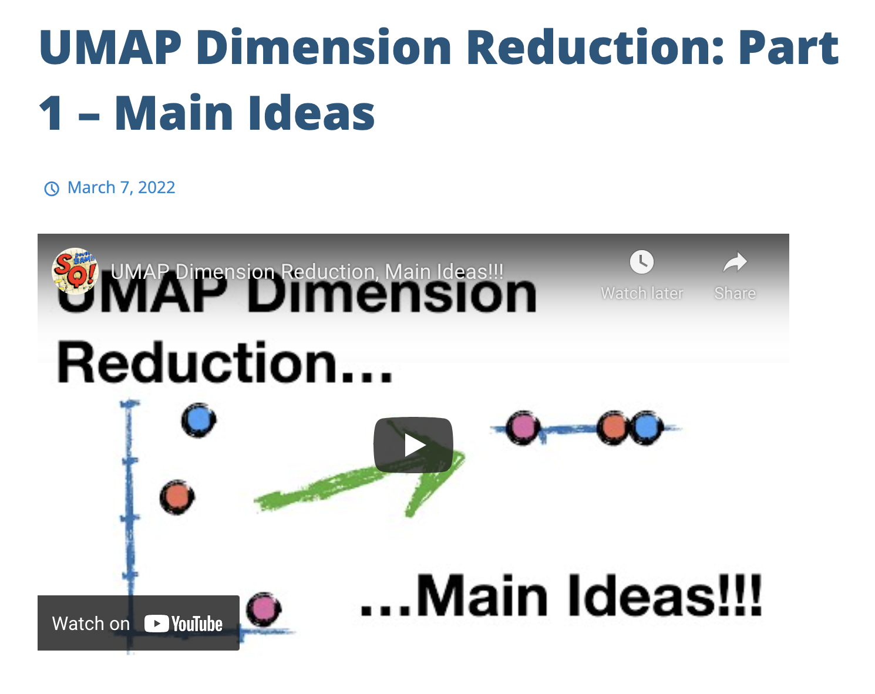
UMAP and TSNE
I personally think TSNE/UMAP is still useful
To have a global view of your data.
https://twitter.com/lpachter/status/1431326048168202247
https://statquest.org/
Notes:
Lior argued that TSNE or UMAP are useless as his group showed that you can make the UMAP look like any animal if you want. However, I do think TSNE and UMAP gives a way to visualize your single-cell data. Just be careful when you interpret the data. At a high level, both UMAP and TSNE are trying to project the high-dimension data into low dimensions and tries to maintain the global structure of the data.
Do not need to understand the underlying math but do understand the pros and cons of different methods. I would highly recommend the Statquest Youtube Channel by Josh Starmer to understand TSNE, UMAP and many other machine learning concepts. You will love his videos.

Slide 15
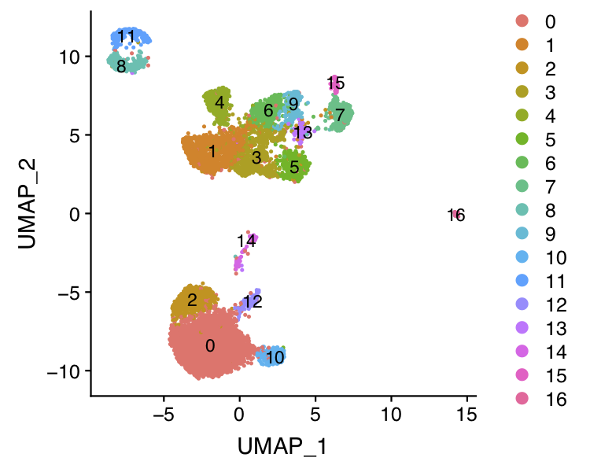
Clustering
Dimension reduction (PCA)
k-means, hierarchical clustering etc
Cluster cells (on the reduced dimensions) using graph-based method in Seurat v3 (Stuart et al, Cell 2019). KNN graph + community detection algorithm
Can visualize using t-SNE / UMAP
Notes:
Raw count matrix🡪 Run PCA, use the top 50 components for clustering. One can use K-means or hierarchical clustering.
The most popular or better performed method is to build a k-nearest neighbor graph in the PCA space and a community detection algorithm is used to define clusters.
The clustering algorithm has many parameters to tune. KNN- you can specify different K. if you specify a small k, you get more clusters, if you Specify bigger resolution, you get more clusters too.
One can always sub-cluster the cells and get more clusters. Theoretically, each cell can be its own cluster right. How similar you want the cells to be within the same cluster.
The function of the mathematically identified clusters need to be interpreted in the context of biology knowledge.
In other words, finding the clusters is math, interpreting the clusters is an art.

Slide 16
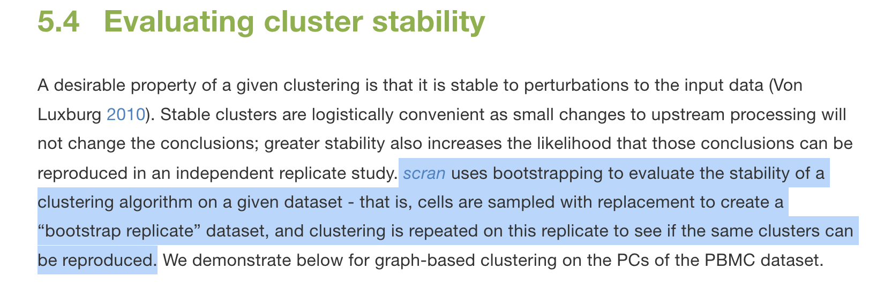
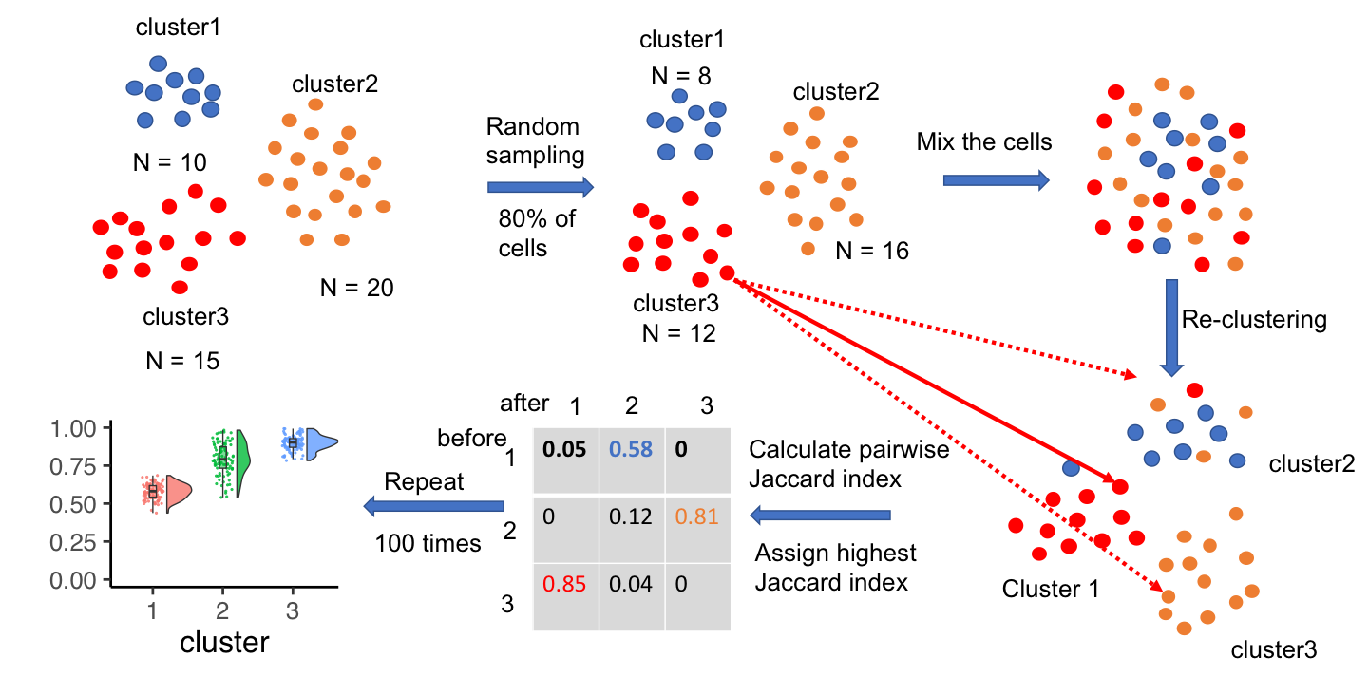
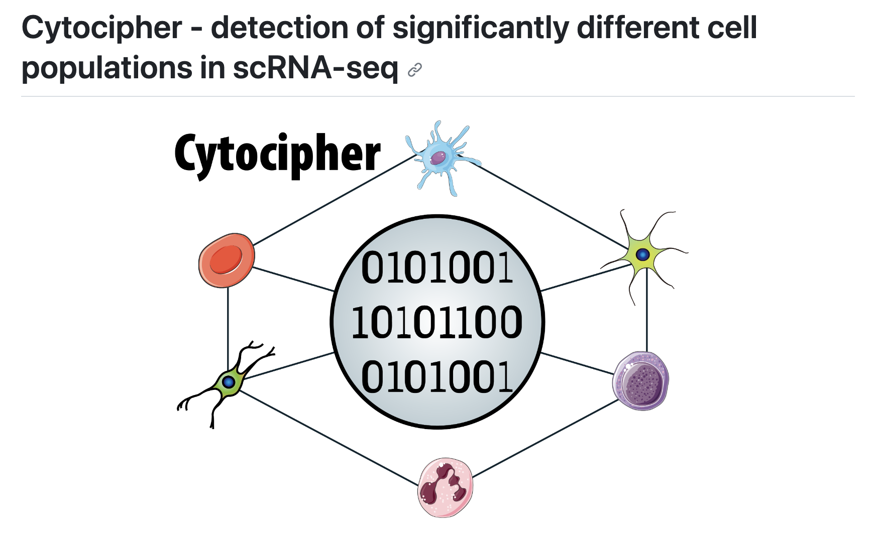
Evaluating cluster stability
Tang et al 2021 Bioinformatics
http://bioconductor.org/books/3.14/OSCA.advanced/clustering-redux.html#cluster-bootstrapping
https://github.com/crazyhottommy/scclusteval
https://github.com/BradBalderson/Cytocipher
Notes:
There are methods to evaluate the cluster stability. Scran uses bootstrapping.
I have a similar method, instead of using boostraping, I use sub-sampling. The idea is similar, if I sub-sample 80% of the cells and re-do the clustering, the cells in the stable clusters tend to stay within the same clusters.

Slide 17
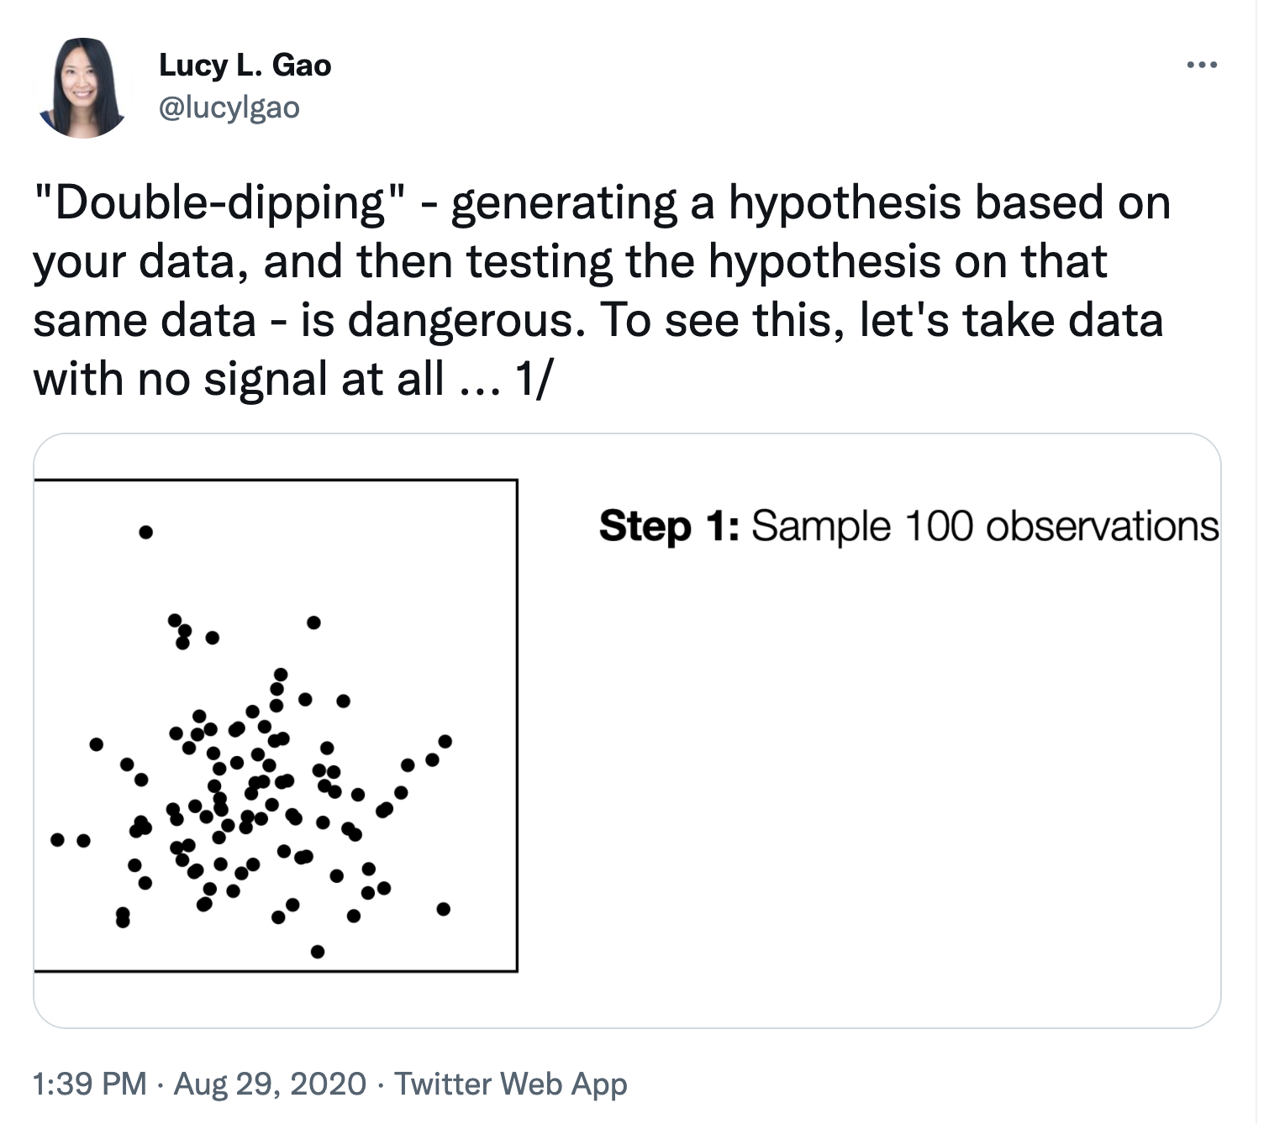
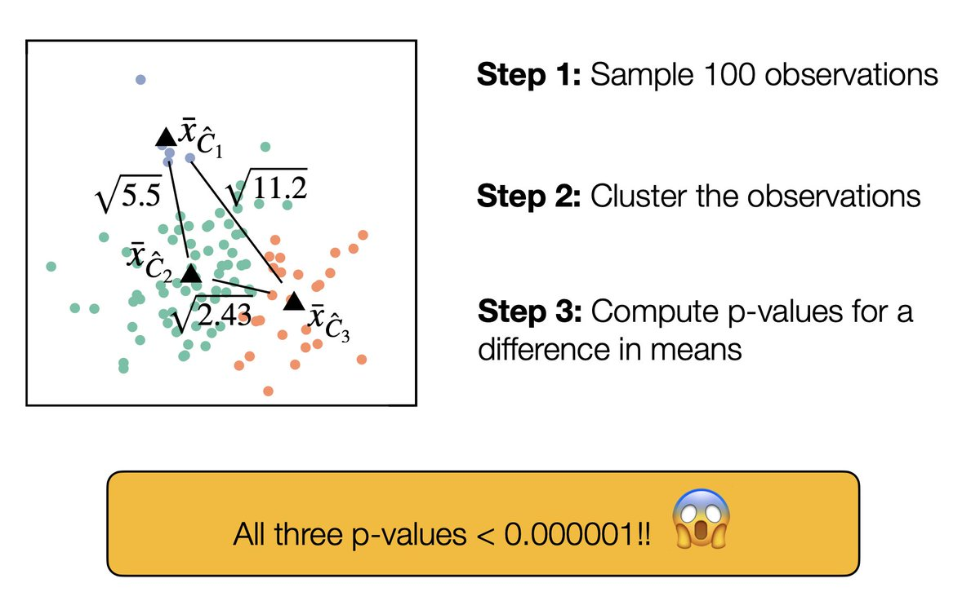
Marker gene p-value is inflated
https://www.lucylgao.com/clusterpval/
https://www.youtube.com/watch?v=voseWZIaFm4
https://www.sciencedirect.com/science/article/pii/S2405471219302698
Notes:
"Double-dipping" - generating a hypothesis based on your data, and then testing the hypothesis on that same data - is dangerous. To see this, let's take data with no signal at all ...
This is relevant in the marker gene identification problem, because we first cluster the cells into different clusters and then calculate the differences for each gene between clusters. We always get tiny p values.

Slide 18
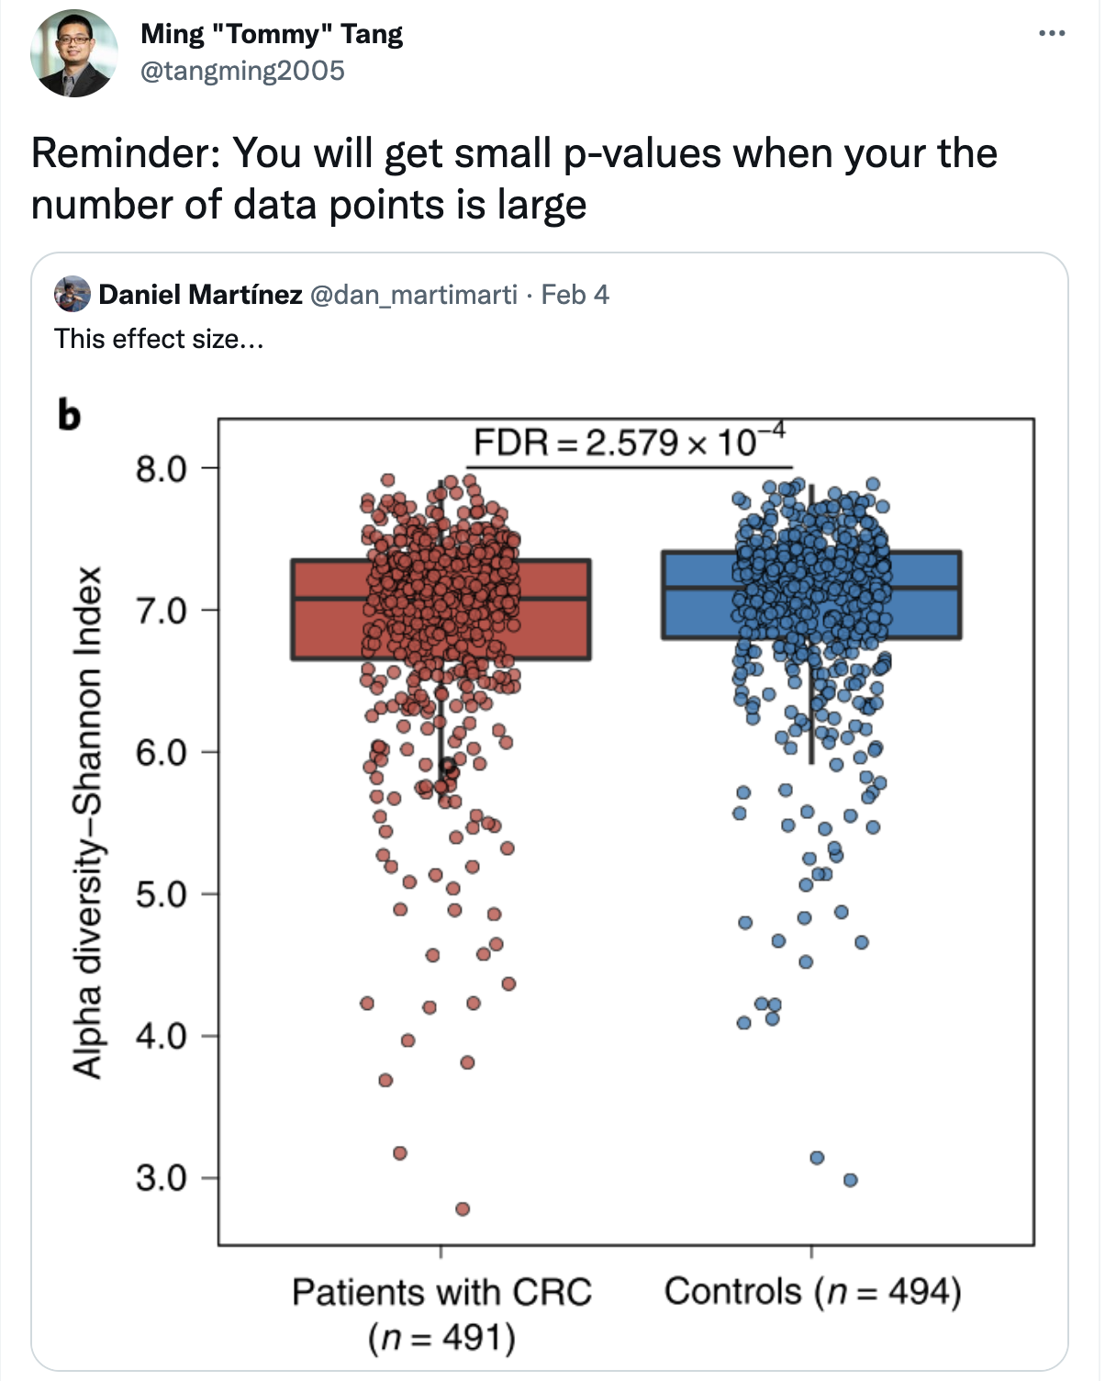
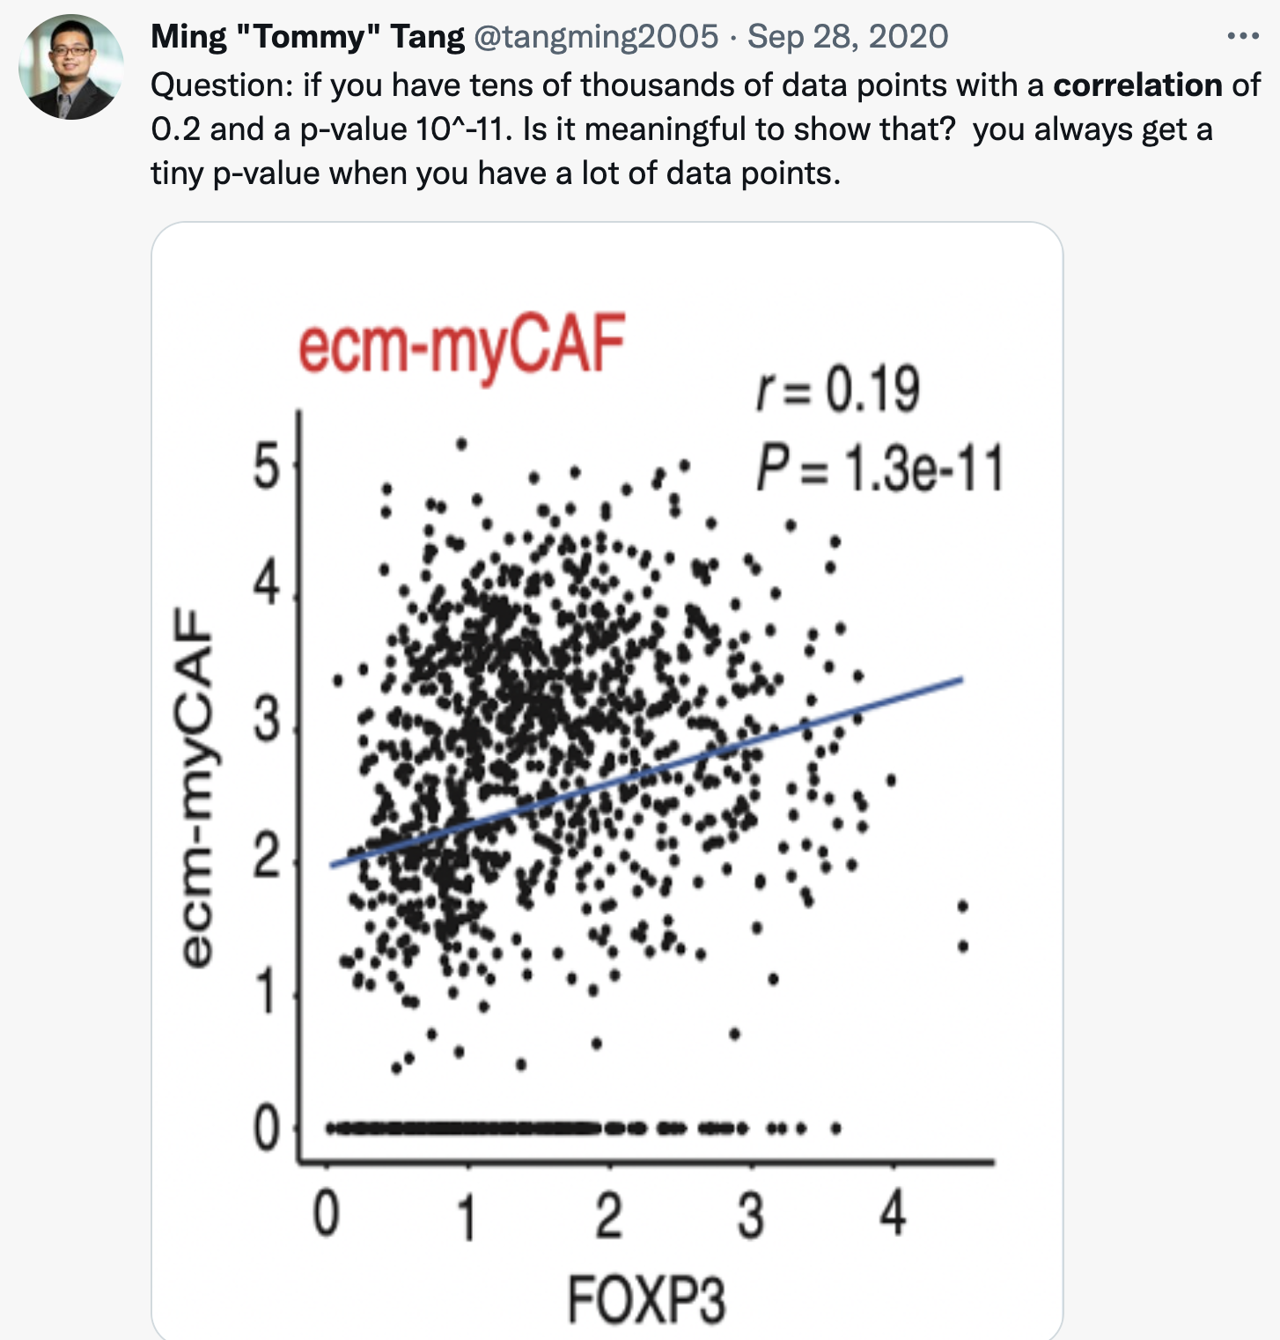
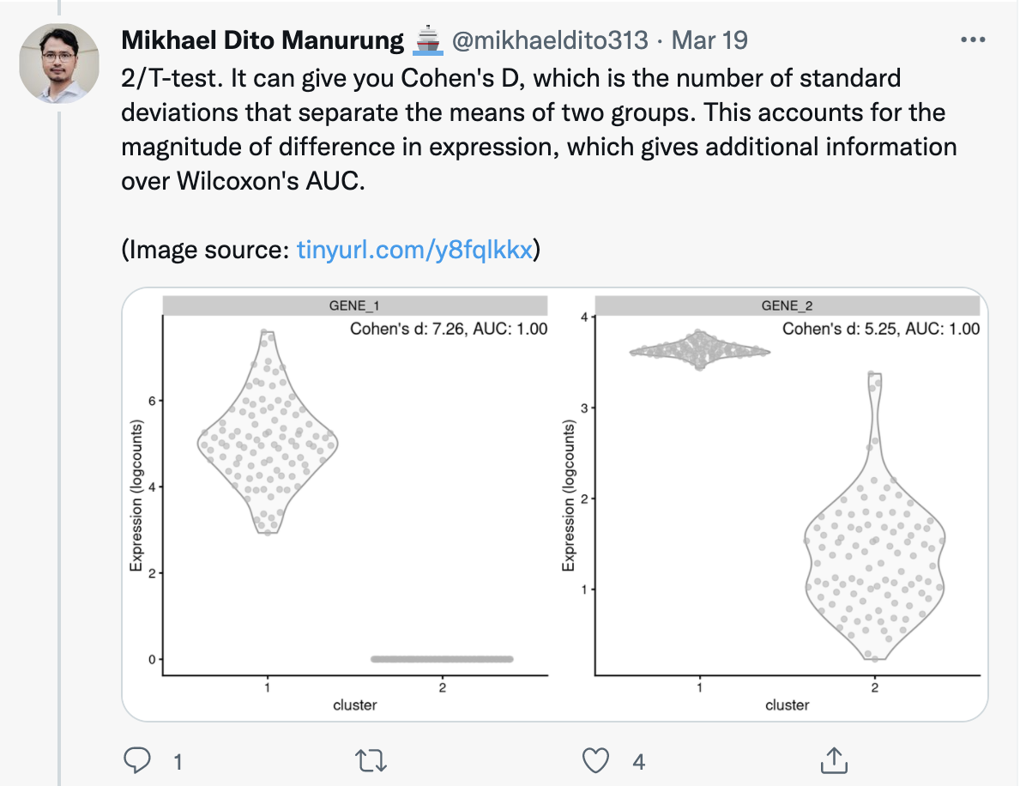
Large number of data points will make p-value tiny
https://twitter.com/tangming2005/status/1489964367336648707
https://mobile.twitter.com/mikhaeldito313/status/1505204061506715649
Notes:
In addition to the double dipping problem, large number of cells in each cluster can be a problem for p-values.
When one has a lot of samples, the p-value can be tiny , but the effect size can be very small. This is the same when you compare two group of samples by t-test/wilcox rank sum test or calculate a p-value for the correlation.
So, let’s emphasize less on the small p-values, but I know we are all duped by p-values.
The other way is to use cohen’s D to measure the effect size. These two genes can have tiny p-values but the effect size is bigger for gene 1 than gene 2. In other words, take the logFC change into account as well.

Slide 19
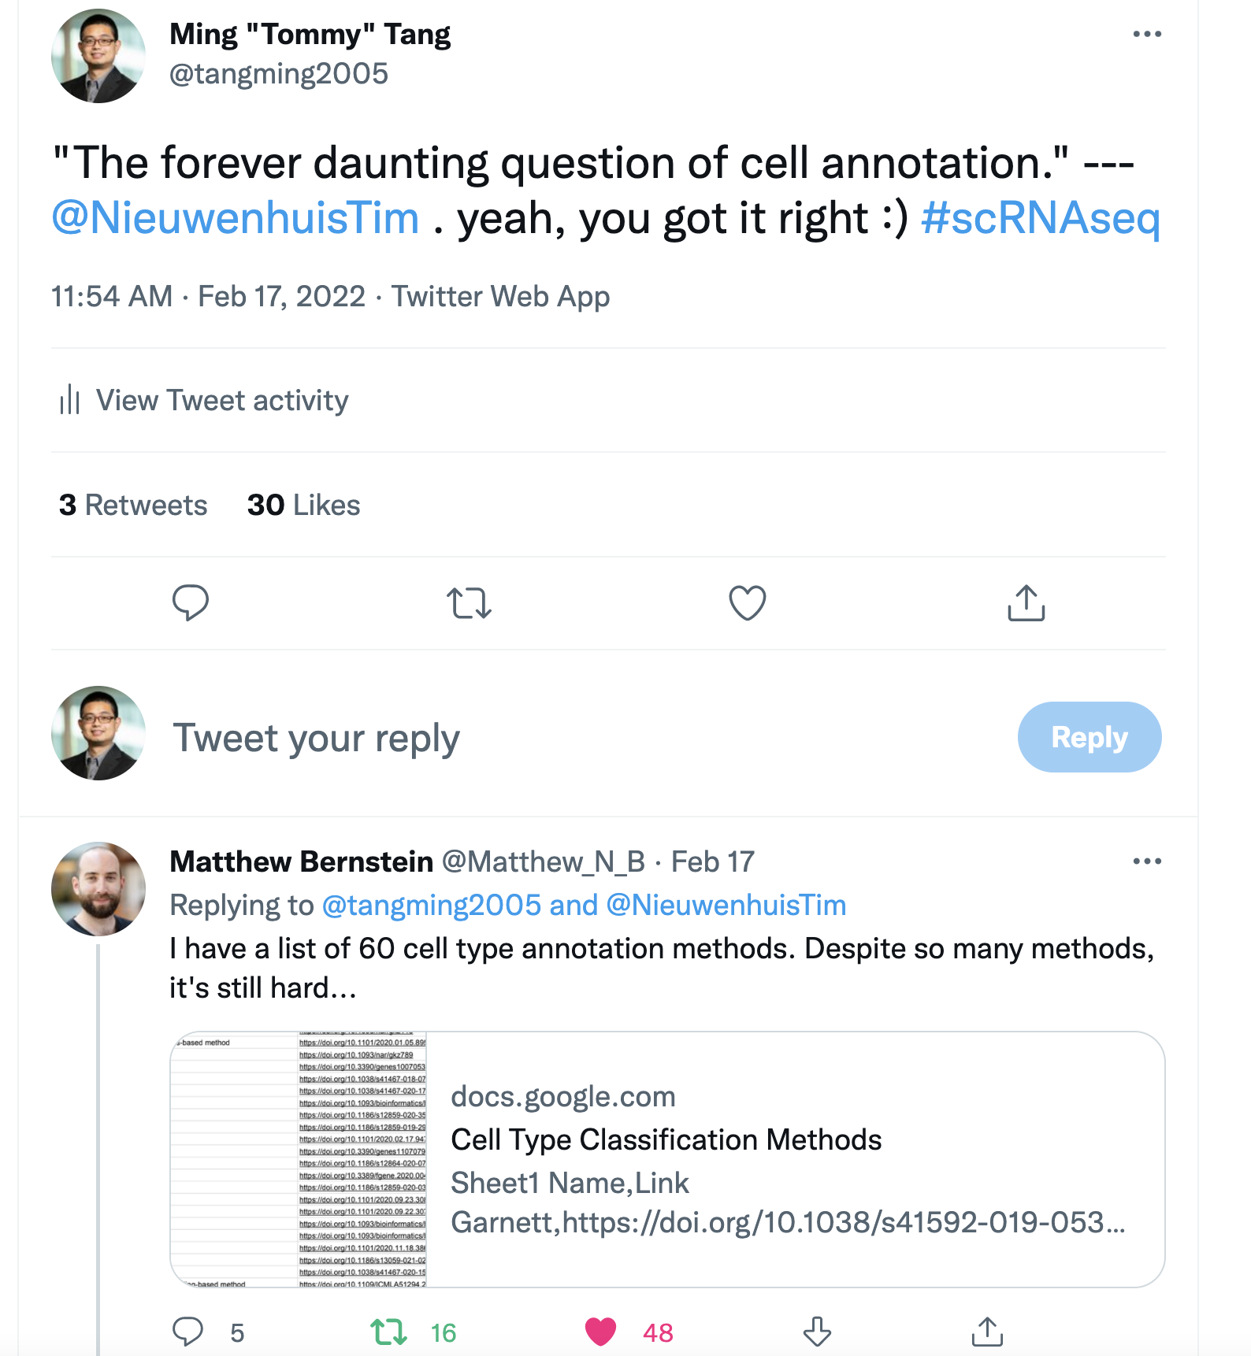
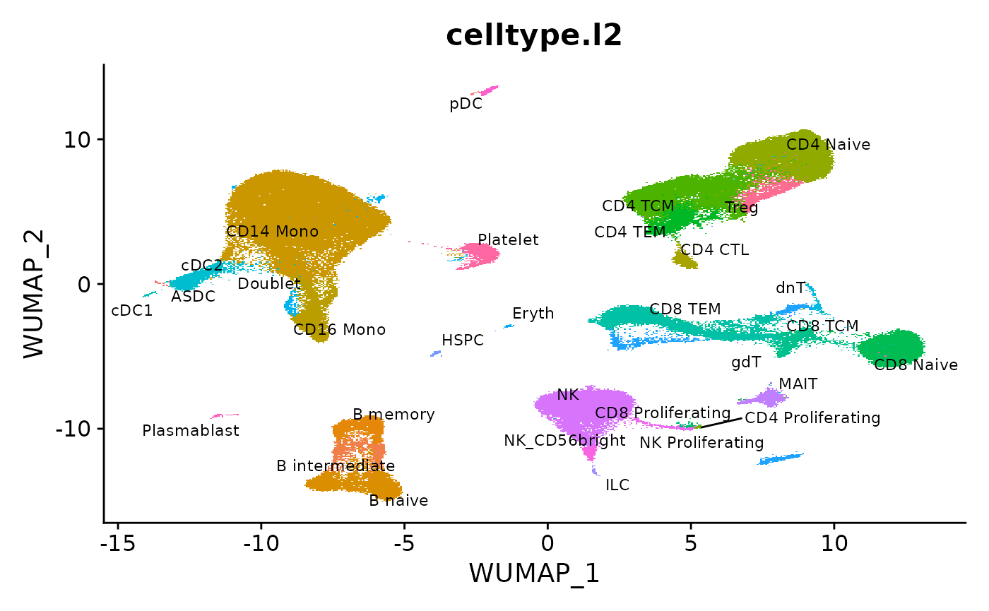
Cell annotation
SingleR
Seurat V4 reference based mapping
https://bioconductor.org/books/3.14/SingleRBook/
https://twitter.com/tangming2005/status/1494354585602998274
Notes:
SingleR compute the Spearman correlation between its expression profile and that of each reference sample, The label with the highest score is used as the prediction. It is simple to use and worked well
Relies on good reference data.
No matter what methods used, the immunologist will manually refine the labels.

Slide 20
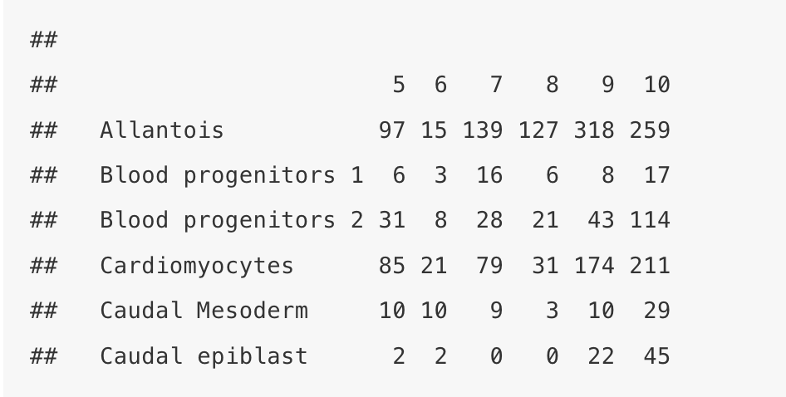
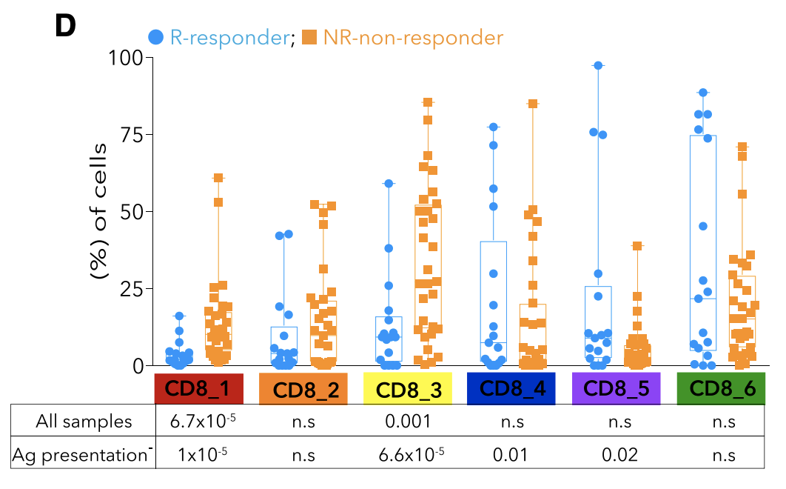
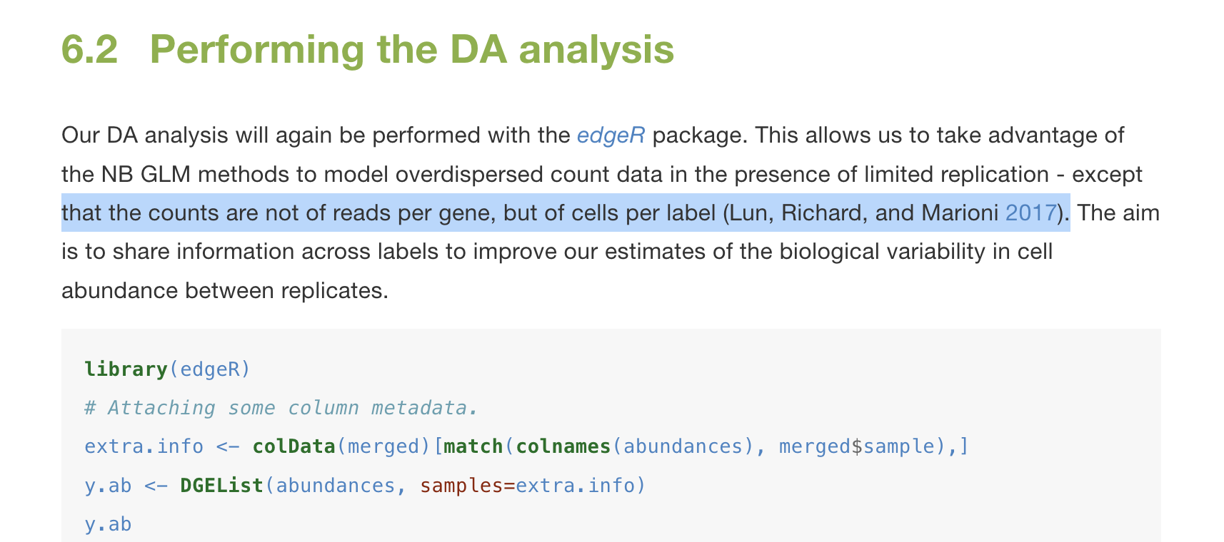
Differential cell abundance analysis
http://bioconductor.org/books/3.14/OSCA.multisample/differential-abundance.html#overview
Notes:
Sampling errors.
Tumors,
It maybe reasonable for PBMCs

Slide 21
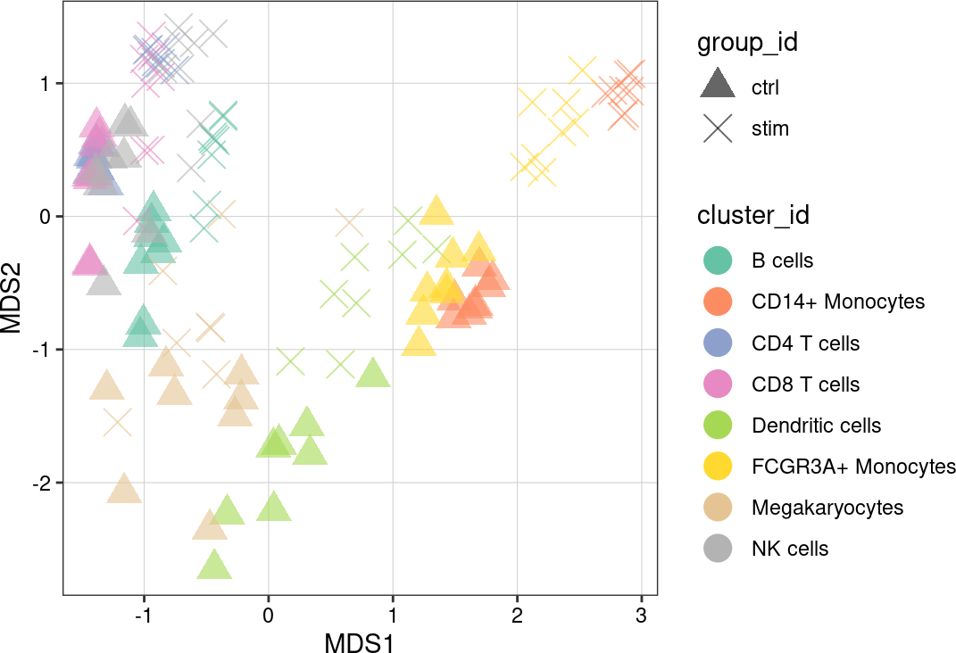
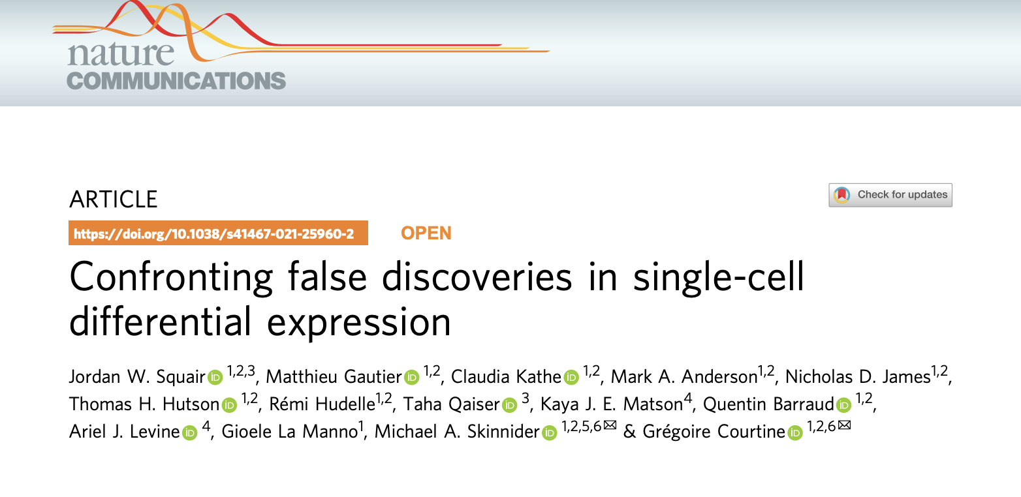
Multi-sample Differential expression: pseudo-bulk for the win
Notes:
Mixed linear model directly model the counts within the same patient and across groups performed well, but very computation intensive. Pseduo-bulk gives comparable results and runs much faster.
For each cluster, you aggregate or sum up the counts for each sample and you get a psedudo-bulk for each cluster for each sample. One can then use DESeq2 or EdgeR that were developed for bulk RNAseq to carry out differential
Expression analysis.

Slide 22
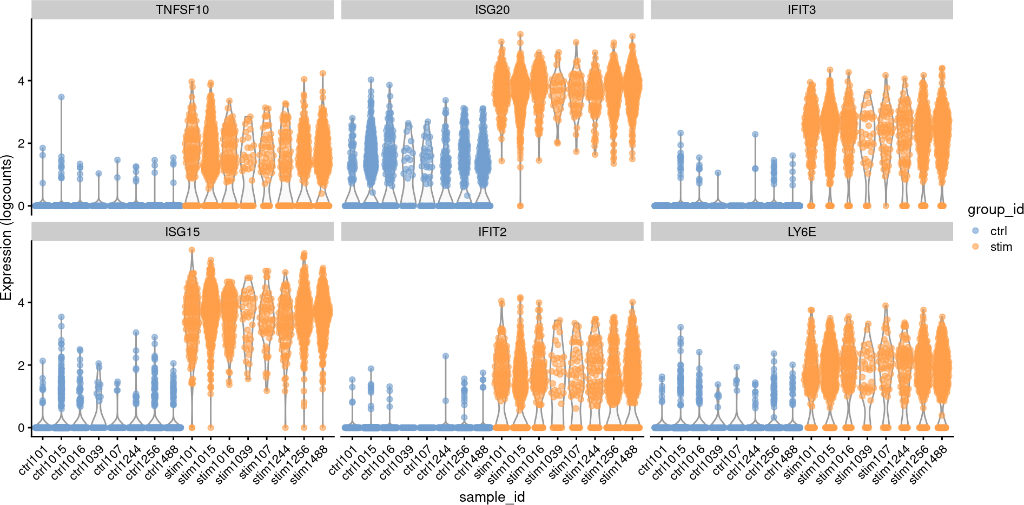
Muscat::pbDS() or Scran::pseudoBulkDEG
https://www.nature.com/articles/s41467-020-19894-4
Notes:
Both Muscat and Scran Bioconductor package have functions to do psedobulk analysis.
Always plot the raw gene expression to check if the results make sense or not. This is a controlled experiment in which you see very nice differences for those genes.
In a more heterogenous experiment where you look for responder vs non-responder for immunotherapy, the results will not be that clean.
If you only show two violin plot in a paper and treat each cell as a replicate, you are likely to see a tiny p-value but then the heterogeneity within the group is masked.
The difference could be well contributed by a single sample.

Slide 23
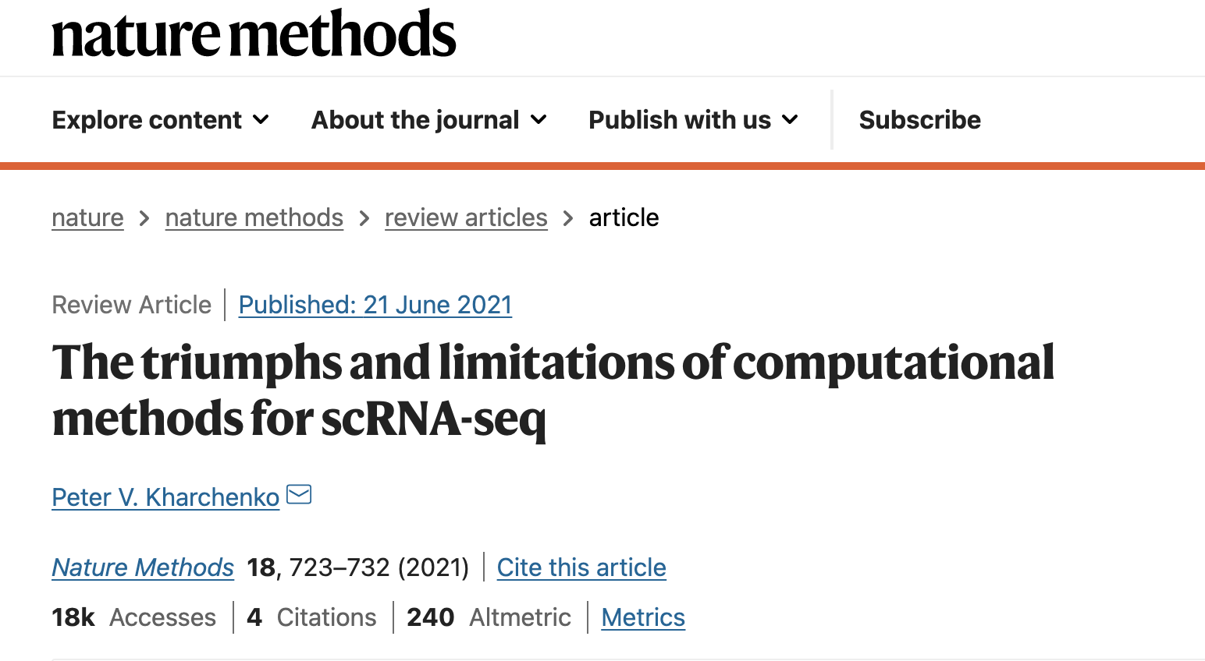
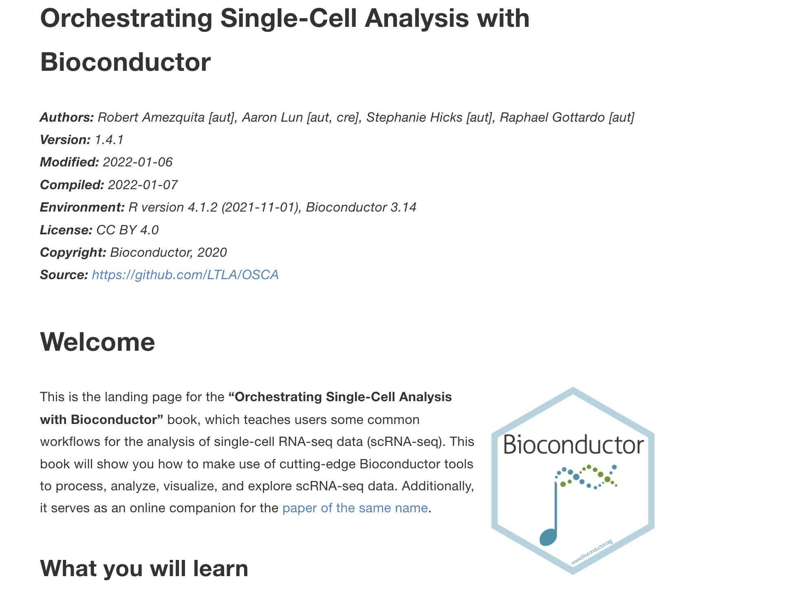
Other resources
https://github.com/seandavi/awesome-single-cell
https://github.com/mdozmorov/scRNA-seq_notes
https://github.com/crazyhottommy/scRNAseq-analysis-notes
https://liulab-dfci.github.io/bioinfo-combio/scatac.html
https://bioconductor.org/books/release/OSCA/
Notes:
Of course, there are other resources that I need to mention.
Single-cell ATACseq

Slide 24
Click subscribe if you liked this content! Thank you.
Happy Learning!
Tommy

